Slide 1
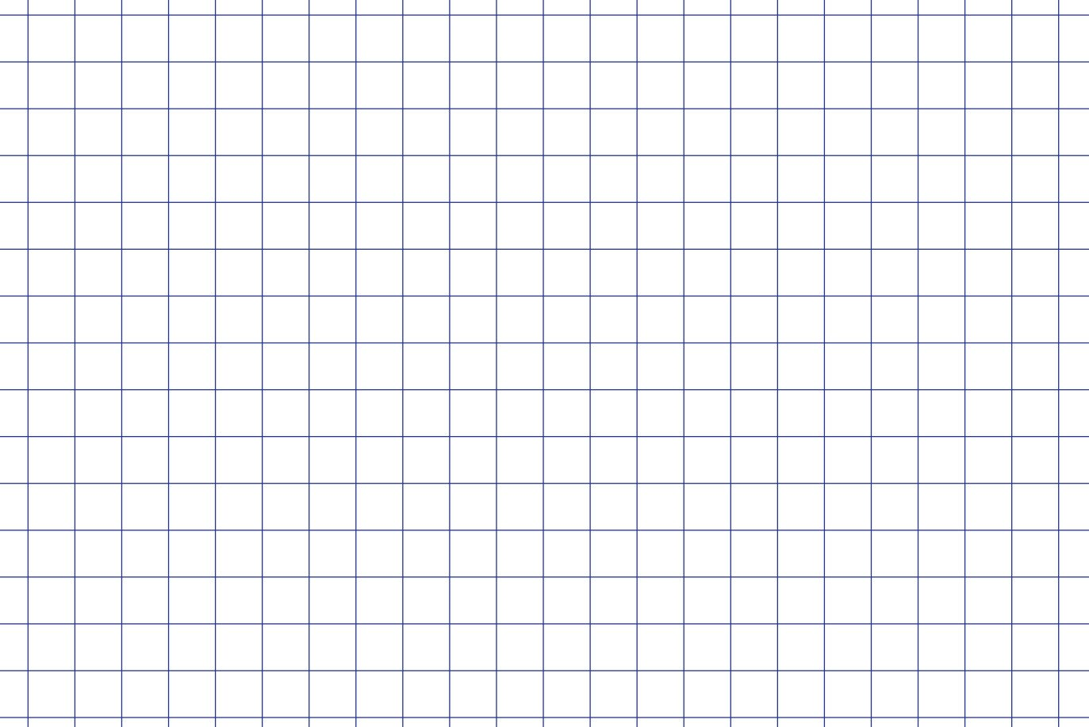


User Interfaces
Python PyQT and QT Designer
Rapid GUI Programming with Python and Qt - The Definitive Guide to PyQt Programming.

Slide 2
GOALS
Consider the basics of good user interface design.
Familiarise ourselves with QT Designer
Examine and modify simple GUIs
Port one of your previous weekly assignments to a GUI program
Share your program on GitHub with a classmate
Making sure your code can run on another machine and that your UI/Code is clear. Include relevant Docs’ if necessary.

Slide 3
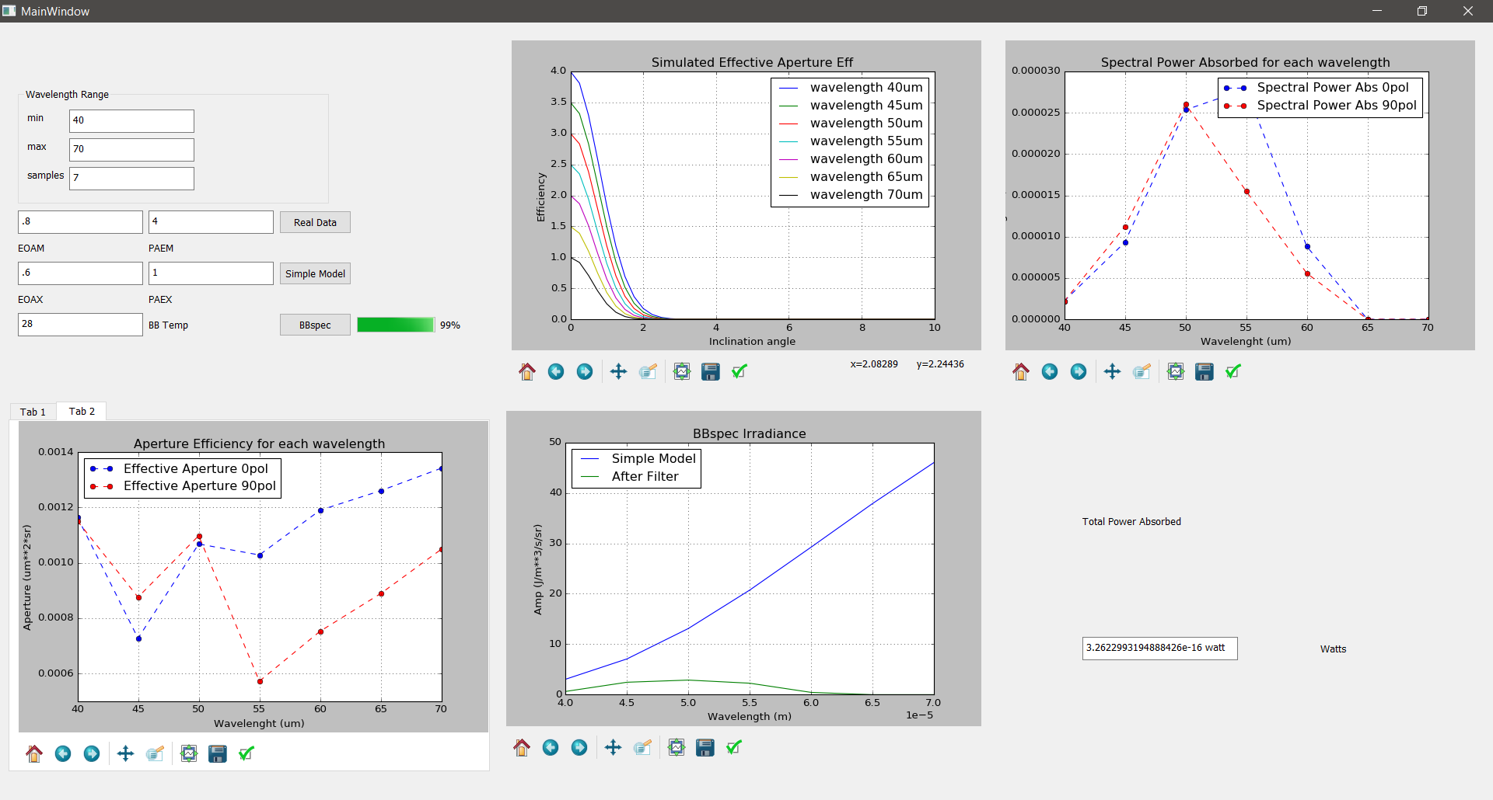

Slide 4
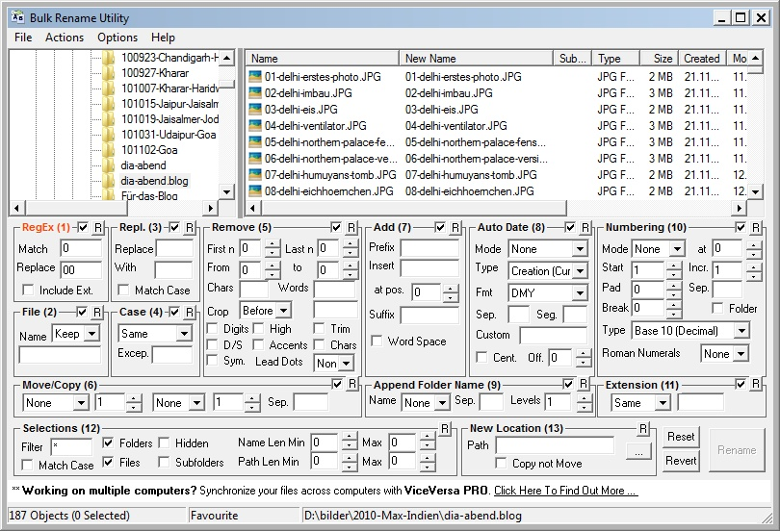
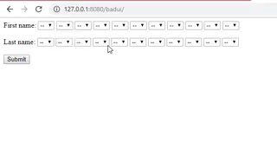
Good UI Design:
The best way to appreciate good UI design is to consider bad UI design.

Slide 5
Good UI Design:
Ideally, we want the user get using the software as easily as possible.
Keep it simple
Informative
Easy to use.

Slide 6
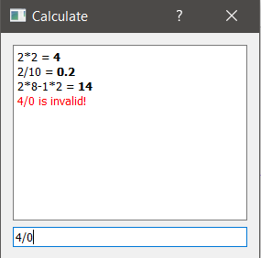
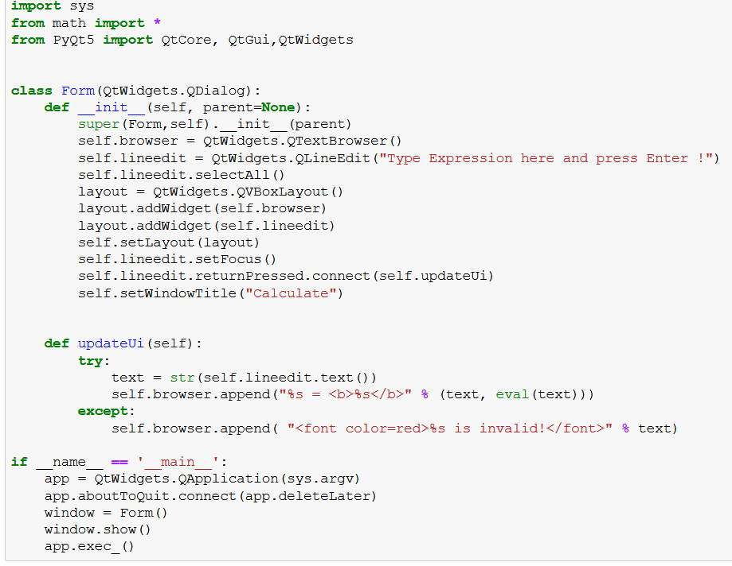
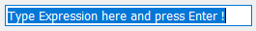
Simple Expression Calculator:

Slide 7
Simple Expression Calculator:
Required Imports: Most of the useful classes have been moved into QtWidgets

Slide 8
Simple Expression Calculator:
Required Imports: Most of the useful classes have been moved into QtWidgets
Build UI Objects, waits for expression to be entered

Slide 9
Simple Expression Calculator:
Required Imports: Most of the useful classes have been moved into QtWidgets
Build UI Objects, waits for expression to be entered
Does the calculation and updated UI

Slide 10
Simple Expression Calculator:
Required Imports: Most of the useful classes have been moved into QtWidgets
Build UI Objects, waits for expression to be entered
Does the calculation and updated UI
Runs the UI and makes sure it exits safely

Slide 11
QT Creator:
Much of the code involved setting up the actual window and this becomes more complicated for more larger projects.
QT Creator allows us to build the window and refer to the objects in the code.
We must be consistent with our naming and the objects we use

Slide 12
Exercise 1:
Lets look at the Simple Expression Calculator converted to a QT project.
Launch Anaconda Prompt:
1. TYPE: jupyter notebook
2. TYPE: designer
Added Line Edit
Added Text Browser

Slide 13
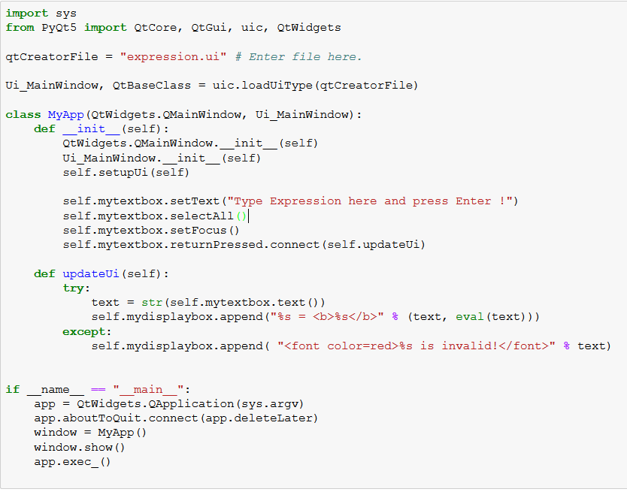
Exercise 1:
Required Import & Load our prebuilt UI.

Slide 14
Exercise 1:
Required Import & Load our prebuilt UI.
Initialize UI, Allow for reference to UI objects i.e. self.mytextbox
As before, preform calculation.

Slide 15
Exercise 1:
Required Import & Load our prebuilt UI.
Initialize UI, Allow for reference to UI objects i.e. self.mytextbox
As before, preform calculation.
Runs the UI and makes sure it exits safely

Slide 16
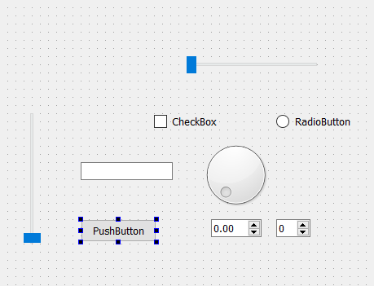
QT Creator:
Gives us much a lot of choice in the way of user input. Buttons, Boolean boxes, sliders, line inputs etc.

Slide 17
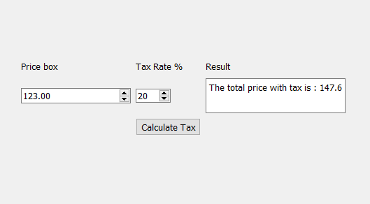
Exercise 2:
Calculate tax example:
Uses double spin box for input
Uses int spin box for tax rate%
Uses Button for action
Display in line edit box
We will add a discount button and spin box to this example.

Slide 18
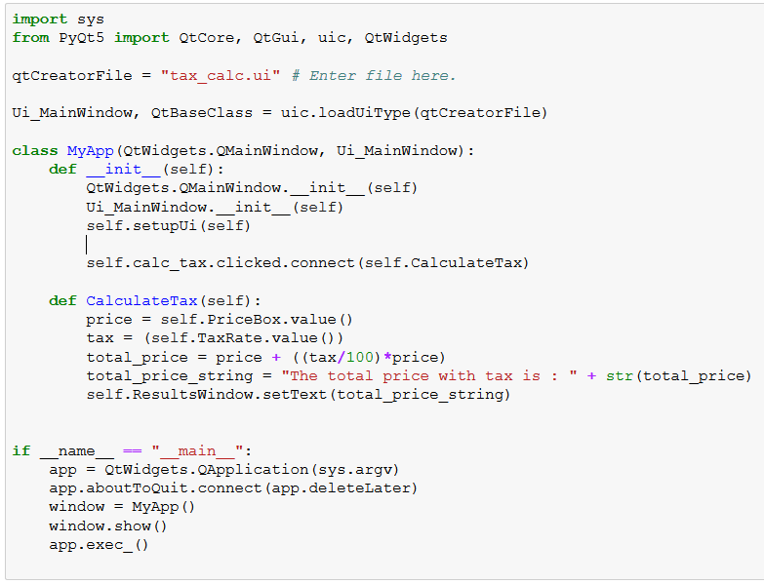
Exercise 2:
Shows how we interact with these input widgets!

Slide 19
QT Creator:
The last thing which might be useful is plotting creating plots with QT creator.
This is a little tricky so we’ll just outline the method and go through the example code.
QT has no plugin for matplotlib so we have to cheat a bit.

Slide 20
Matplotlib window:
QT SIDE:
Add a Container->Widget
Drop any object into this widget
Apply a layout (GRID) to the widget
Delete the object you dropped in.
Name the widget mplwindow_1 and name its layout mplvl_1
Add input boxes & plot button as before.
DONE with the QT side of things

Slide 21
Matplotlib window:
PYTHON SIDE:
Set up as per usual
Need to have functions to add and remove plots
See addmpl and rmmpl in the example code
These must refer to the widget you have set up!
Need to add blank plot in our __init__ state
Since we remove the previous plot displayed.
Matplotlib backend must be used as we apply a canvas to the widget which is then plotted on.
See example code for how this is implemented.

Slide 22
Matplotlib window:
This work around has been implemented as a pluggin with QT designer in the latest update.
But it doesn’t come as standard.

Slide 23
Final Exercise:
Convert one of your own programs.
(I would suggest importing it as a package a just referring to it when needed in the UI program)
Share this with a class mate to ensure:
It can run on another's machine.
They can work out how to use it.

